Slide 1
TITLE:
AUTOMATIC NUMBER PLATE RECOGNITION SYSTEM
Supervisor:
By:
Ms. Akula Rajitha
Assistant Professor
S. Poornoday Reddy

Slide 2
Outline
Introduction
Problem Statement
Significance of the Research
Literature Review
Data Collection
Methodology
Results and Analysis
Conclusion
Future Scope

Slide 3
Introduction
Automatic Number Plate Recognition (ANPR) .
ANPR system revolutionizes transportation and security.
ANPR technology's significance in real world.
Adaptive algorithms ensure ANPR resilience in diverse conditions.
Project outcomes.

Slide 4
Problem Statement
To Develop a robust ANPR system for accurately recognizing vehicle license plates from images
To make an ANPR system that addresses challenges of real world.
To Improve ANPR system efficiency.
To Create a scalable solution adaptable to different environments and plate formats, seamlessly integrating with existing infrastructure and software systems.

Slide 5
Significance of the Research
ANPR technology Algorithms.
ANPR system working phases.
ANPR working components.
Addressing different real world constraints.
Improving efficiency of ANPR systems.

Slide 6
Literature Review
ANPR technology Algorithms.
ANPR system working phases.
ANPR working components.
Addressing different real world constraints.
Improving efficiency of ANPR systems.

Slide 7
Literature Review
S. No | Author/Title/ Journal / Year | Observation
1 | A. Kashyap, B. Suresh, A. Patil, S. Sharma and A. Jaiswal, "Automatic Number Plate Recognition," 2018 International Conference on Advances in Computing, Communication Control and Networking (ICACCCN), Greater Noida, India, 2018, pp. 838-843, doi: 10.1109/ICACCCN.2018.8748287. | A. Kashyap, B. Suresh, A. Patil, S. Sharma and A. Jaiswal et al. contributed to the field by addressing advancements in ANPR technology. While research inferred that the paper likely explores existing knowledge and developments in ANPR systems, with a focus on computing, communication, control and networking aspects.
2 | A. K. Singh and S. Roy, "ANPR Indian system using surveillance cameras," 2015 Eighth International Conference on Contemporary Computing (IC3), Noida, India, 2015, pp. 291-294, doi: 10.1109/IC3.2015.7346695. | A. K. Singh and S. Roy et al. presented the a model of an Automatic Number Plate Recognition (ANPR) system in the context of Indian surveillance cameras. While particularly focusing on the Indian scenario and the integration of surveillance cameras. The paper contributes to the field by proposing an ANPR system tailored for Indian conditions, providing insights into its application and effectiveness.

Slide 8
Literature Review
S. No | Author/Title/ Journal / Year | Observation
3 | Dr. Vishwanath Burkpalli, Abhishek Joshi, Abhishek B Warad, Akash Patil "Automatic Number Plate Recognition using Tensorflow and Easyocr" International Research Journal of Modernization in Engineering Technology and Science Volume:04/Issue:09/September-2022. | Dr. Vishwanath Burkpalli, Abhishek Joshi, Abhishek B Warad, Akash Patil et al. [5] proposed the application of TensorFlow and EasyOCR for ANPR. While the research likely delves into existing studies on ANPR, with a particular emphasis on the integration of TensorFlow and EasyOCR for localizing and detecting number of license plate.
4 | I. V. Pustokhina et al., "Automatic Vehicle License Plate Recognition Using Optimal K Means With Convolutional Neural Network for Intelligent Transportation Systems," in IEEE Access, vol. 8, pp. 92907-92917, 2020. | I. V. Pustokhina et al. [6], presented a comprehensive exploration of an innovative approach to Automatic Vehicle License Plate Recognition (ALPR). The study focuses on the integration of Optimal K-Means clustering and Convolutional Neural Networks (CNNs) to enhance the efficiency of ALPR systems within the context of Intelligent Transportation Systems (ITS). Optimal K-Means clustering is employed as a preprocessing step, effectively isolating license plates from complex backgrounds.

Slide 9
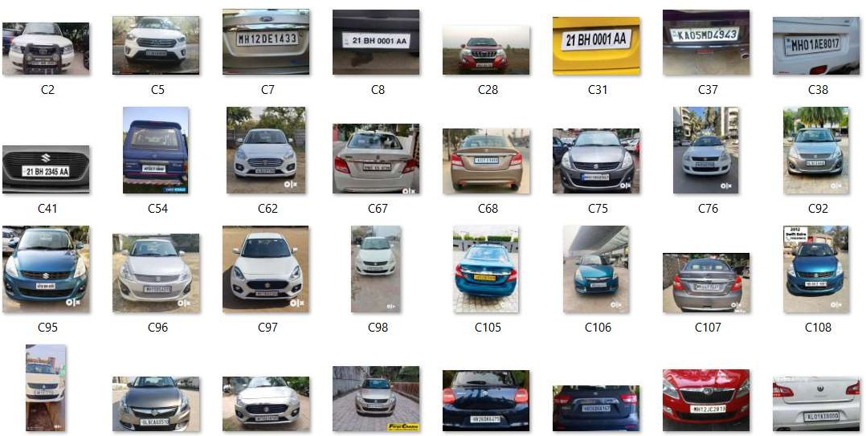
Data Collection
Dataset images are from Roboflow Universe, Kaggle
Fig 1: Dataset

Slide 10
Methodology
Our Implemented model includes phase:
Image Acquisition
Preprocessing
Plate Localization
Plate Segmentation
Character Recognition
Post-processing
Data Validation and Interpretation
Integration and Output

Slide 11
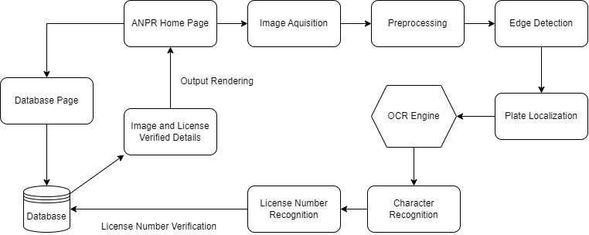
System Architecture
Fig 2: Architecture diagram

Slide 12
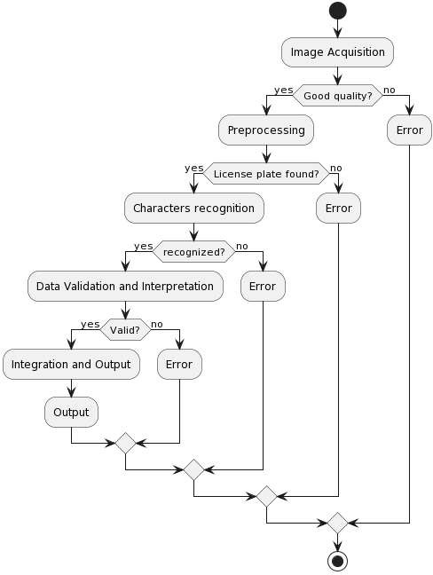
System Work Flow
Fig 3: Process Flow

Slide 13
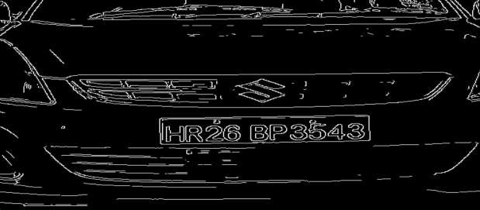
Algorithm Working Steps
Algorithms:
Canny edge detection
Optical Character Recognition (OCR)
Canny edge detection:
Multistage Edge Detection
Gaussian Smoothing
Gradient Calculation
Non-Maximum Suppression
Hysteresis Thresholding
Fig 3: Canny Edge Detection

Slide 14
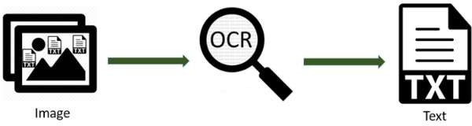
Implemented Algorithm Working Steps
Optical Character Recognition (OCR):
Text Extraction
Character Segmentation
Feature Extraction
Classification and Recognition
Post-processing and Error Correction
Fig 4: Optical Character Recognition

Slide 15
Results and Analysis
Our implemented model is able to :
Acquire image
Preprocess the acquired image
Detect License Plate
Localize License Plate
Recognize Characters of License Plate
Output the Text of License Plate
Recognize License Number Plates
70% Accuracy in different constraints

Slide 16

Results of Implemented model
Fig 5: UI of Website for ANPR system

Slide 17
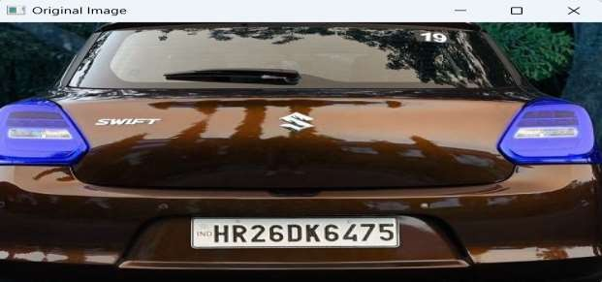
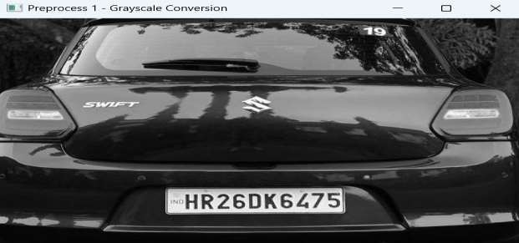
Results of Implemented model
Fig 5: Resized image of Original Image
Fig 6: Grayscale converted Image

Slide 18
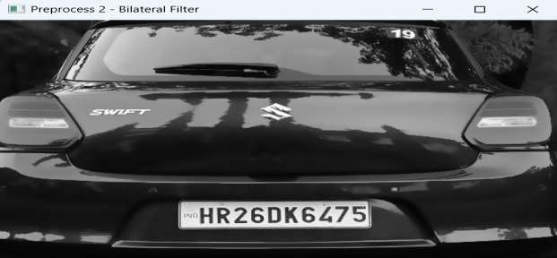
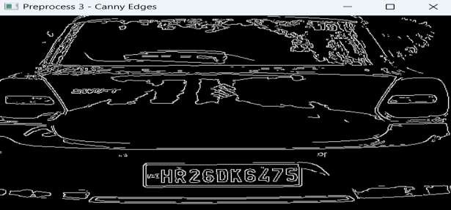
Results of Implemented model
Fig 7: Bilateral Filtered image
Fig 8: Canny Edges detected Image

Slide 19
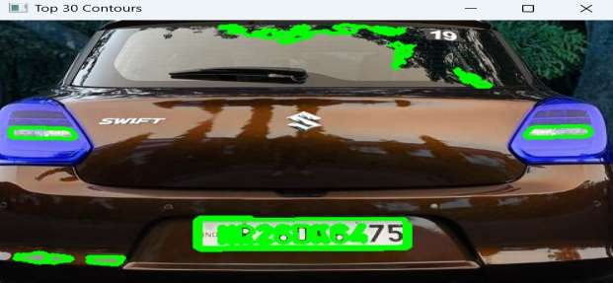

Images of Implemented model
Fig 9: Top 30 contours of image
Fig 10: Localized Plate image

Slide 20
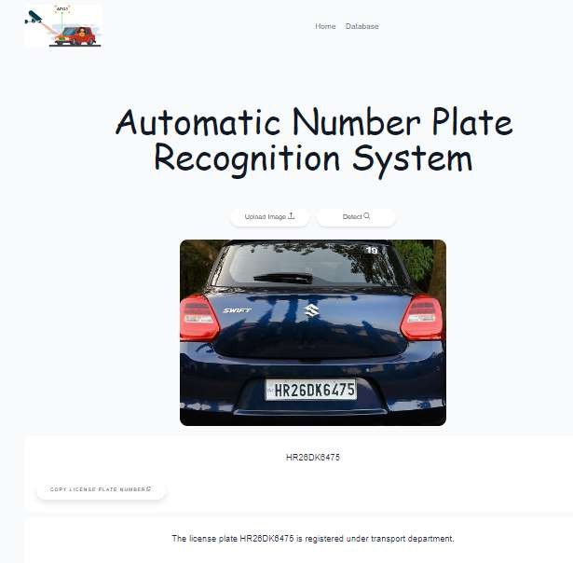
Results of Implemented model
Fig 11: Number plate recognized and output of number as text in the website.

Slide 21
Conclusion
ANPR system stands as a revolutionary technology, offering substantial benefits in transportation, security, and
urban management.
The systematic three-stage method of preprocessing, license plate localization, and character recognition has
proven effective in automating vehicle identification based on license plates.
ANPR becomes indispensable for enhancing public safety, law enforcement, and traffic management in smart
cities' development.
Future breakthroughs in ANPR are expected through integration with advanced technologies like machine learning
and artificial intelligence, along with cloud-based solutions for scalability and connectivity.
Challenges lie ahead, including balancing user privacy with technical progress, addressing ethical considerations, and ensuring responsible data processing to maintain ANPR's role in safer and more integrated urban environments.

Slide 22
Future Scope
Future ANPR systems evolvement
Future ANPR Integration
ANPR's adaptability to shifting urban transportation and security needs.
Resolving security and privacy concerns will be a priority.
International standardization and interoperability initiatives for ANPR.

Slide 23
Thank You

